Slide 1
Team 1 – The 4 Nearest Nieghbors
Adil Ashish Kumar, Daniel Byun, Ivy Zhou, Jiaqi Chen

Slide 2
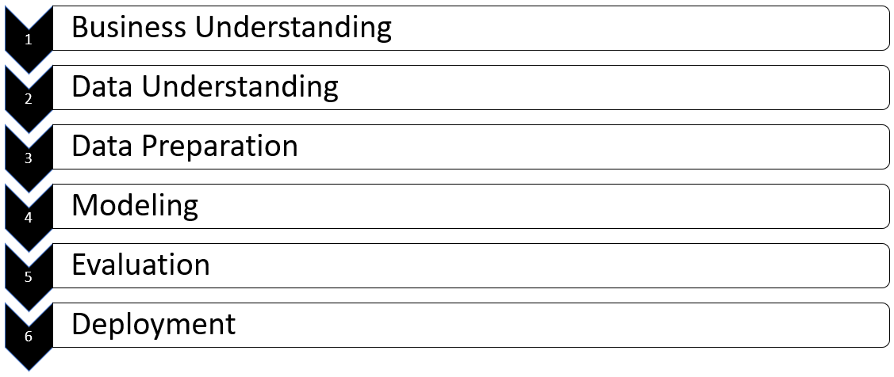
Overview

Slide 3
Business Understanding

Slide 4
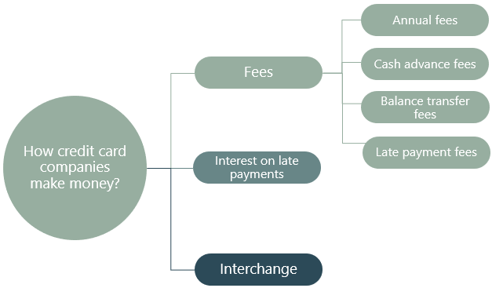
Business Understanding
Business Background
Problem: A bank in Taiwan wants to identify customers at risk of credit card default
Default: To default is to fail to make a payment on a debt by the due date

Slide 5
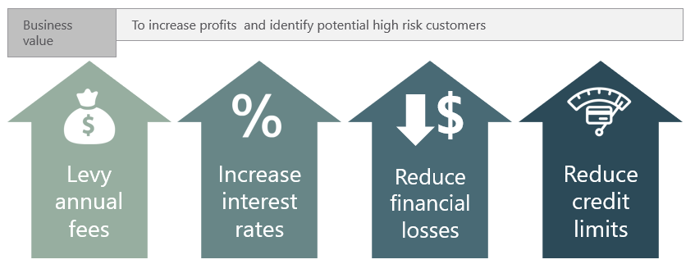
Business Understanding

Slide 6
Data Understanding

Slide 7
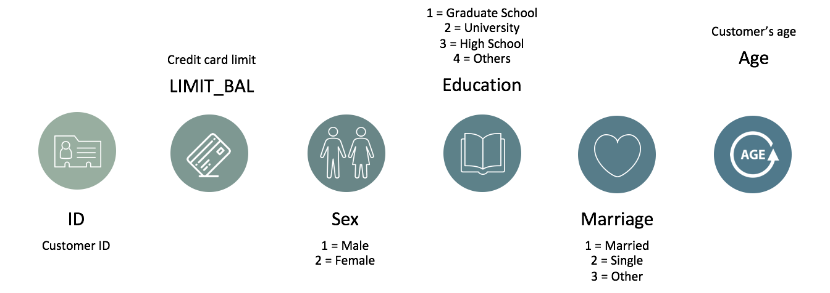
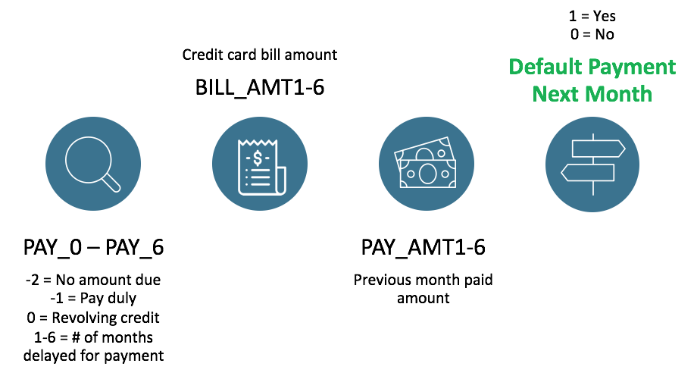

UCI - Default of Credit Card Clients Data Set
Amount paid that
month

Slide 8
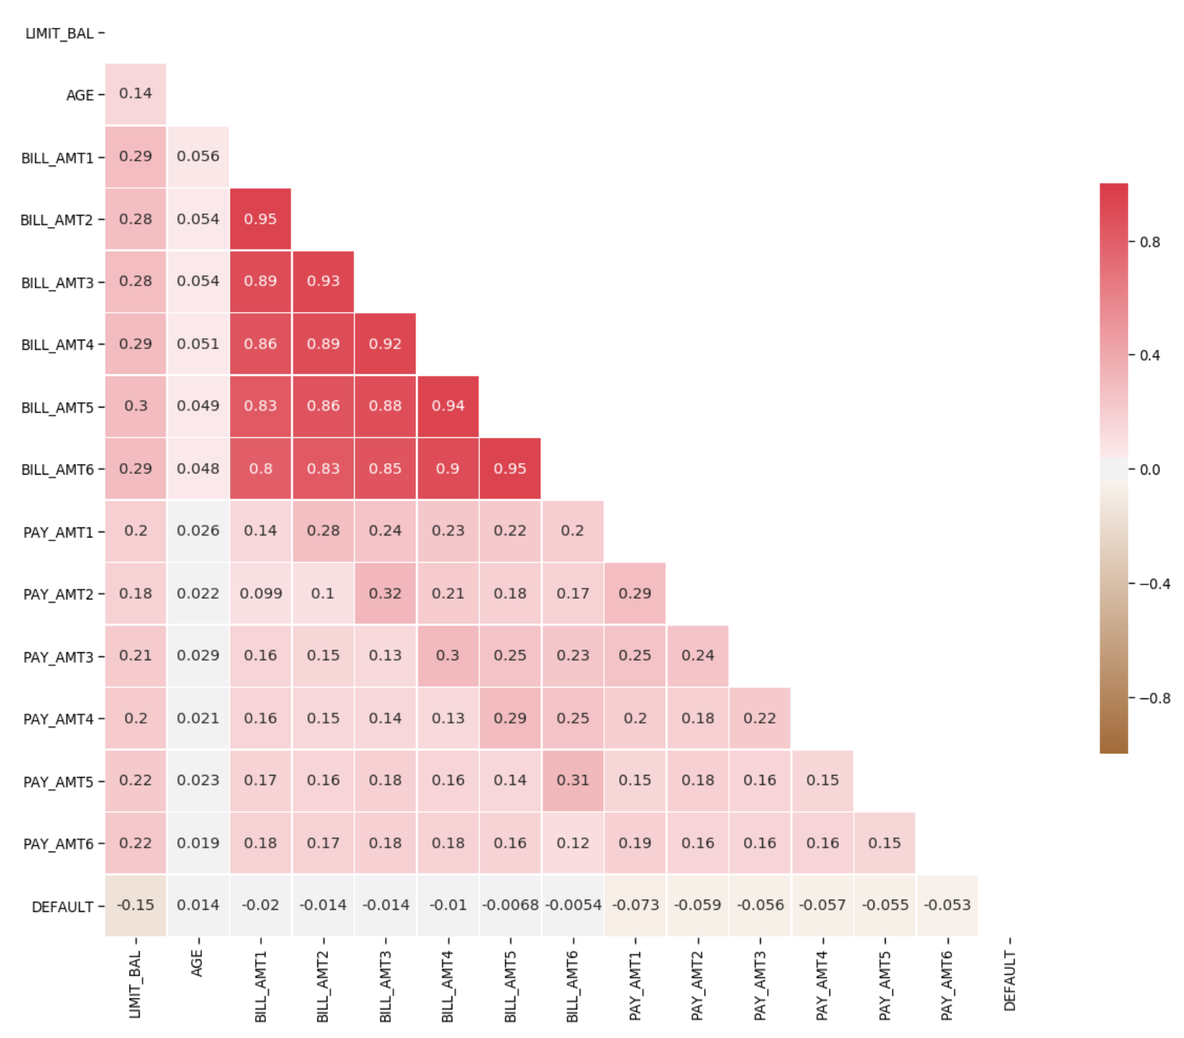
Insights from EDA
1 ID column, 23 predictors and 1 target variable – 30000 observations
Many similar variables – possible multicollinearity and the curse of dimensionality
Mismatch in values with data dictionary

Slide 9
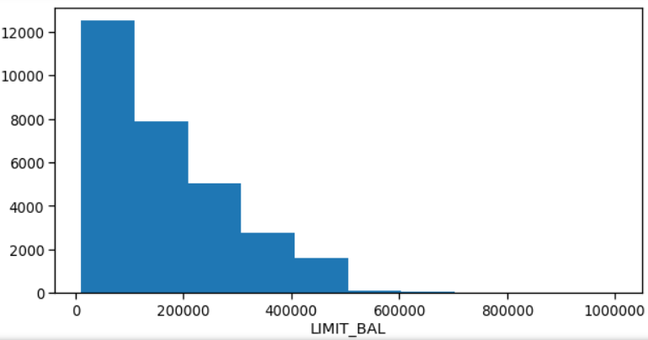
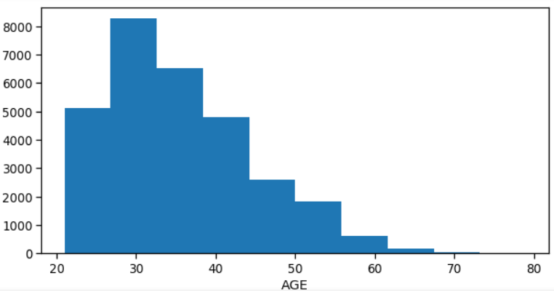
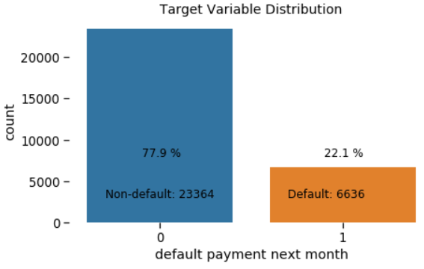
Insights from EDA
Skewness in continuous variables
Slight imbalance in the target variable class distribution
Data science problem:
Classification problem: Predict if the customer will default on the next payment.
Class probability estimation can also be used to rank customers based on their risk of default.

Slide 10
Data Preparation

Slide 11
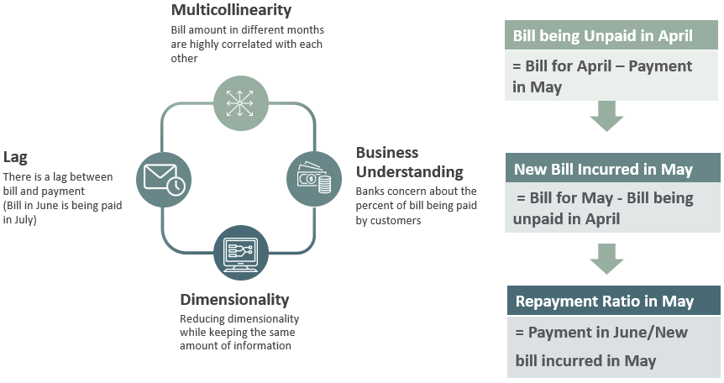
Pay Ratios

Slide 12
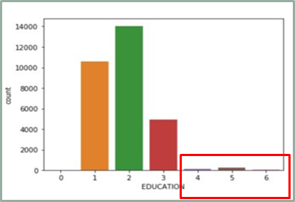
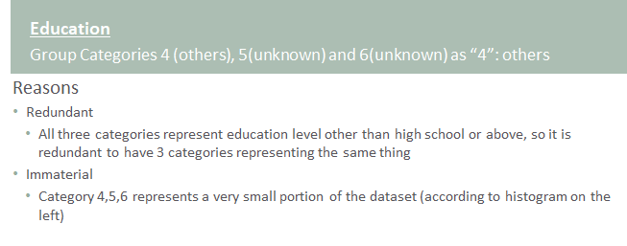
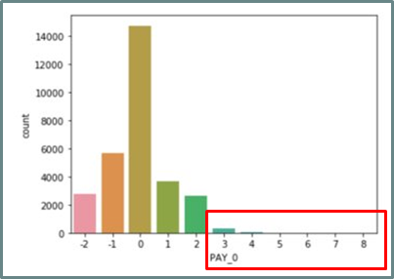
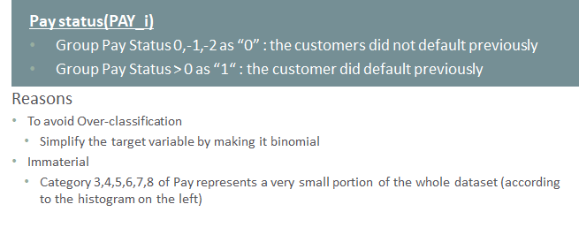
Grouping Categories

Slide 13
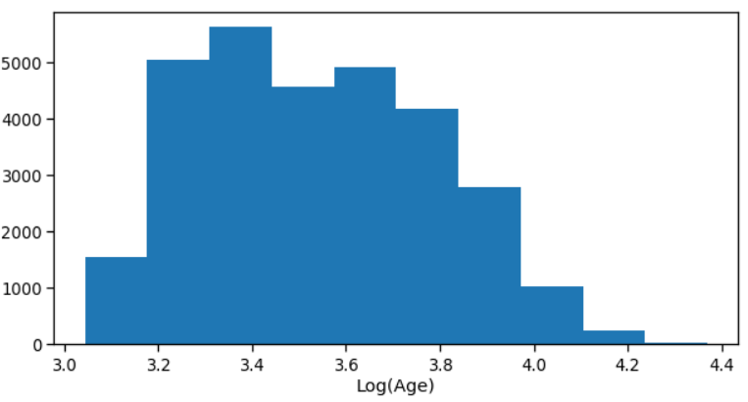
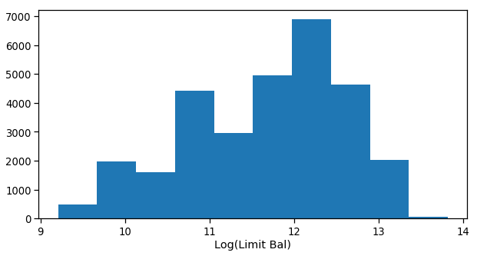
Log Transformations

Slide 14

Converting Categorical to Dummy Variables

Slide 15
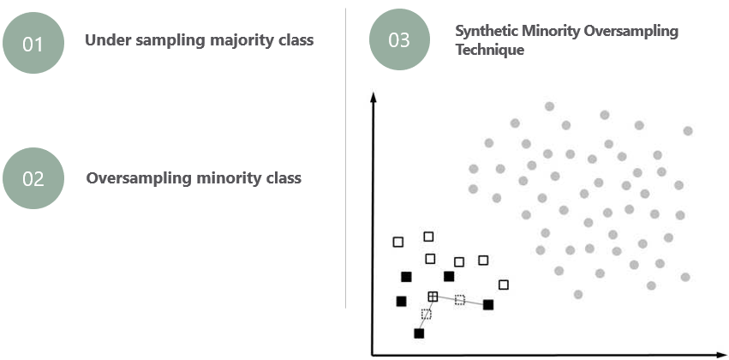
Dealing with Class Imbalance – Target Variable
Goal is to convert 78:22 to 55:45 for Non default:Default

Slide 16
Modeling

Slide 17
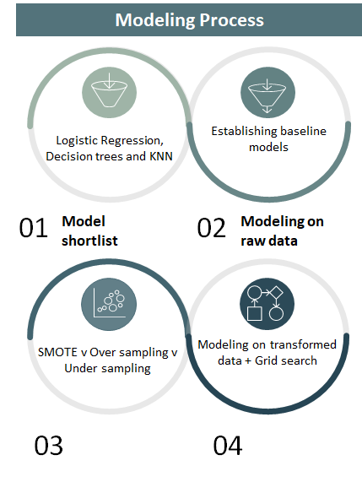
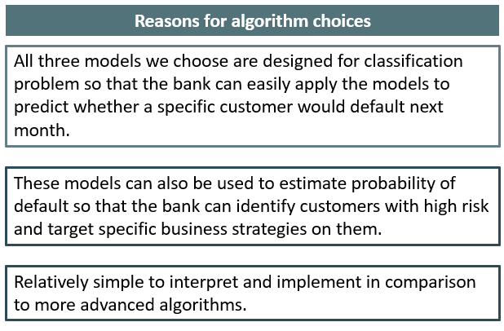
Modeling process

Slide 18
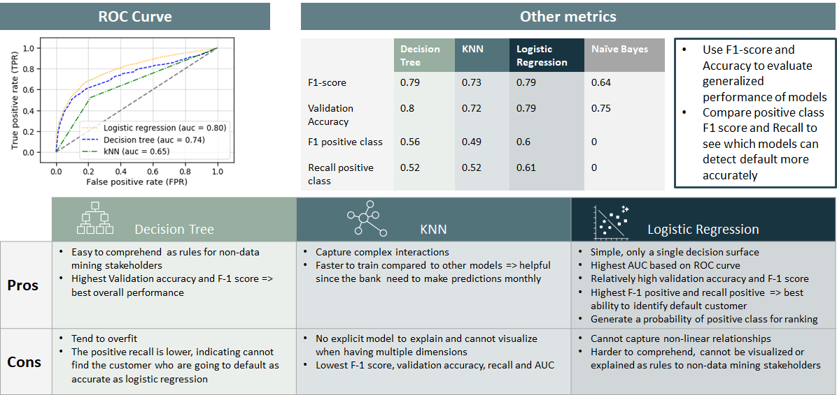
Model results

Slide 19
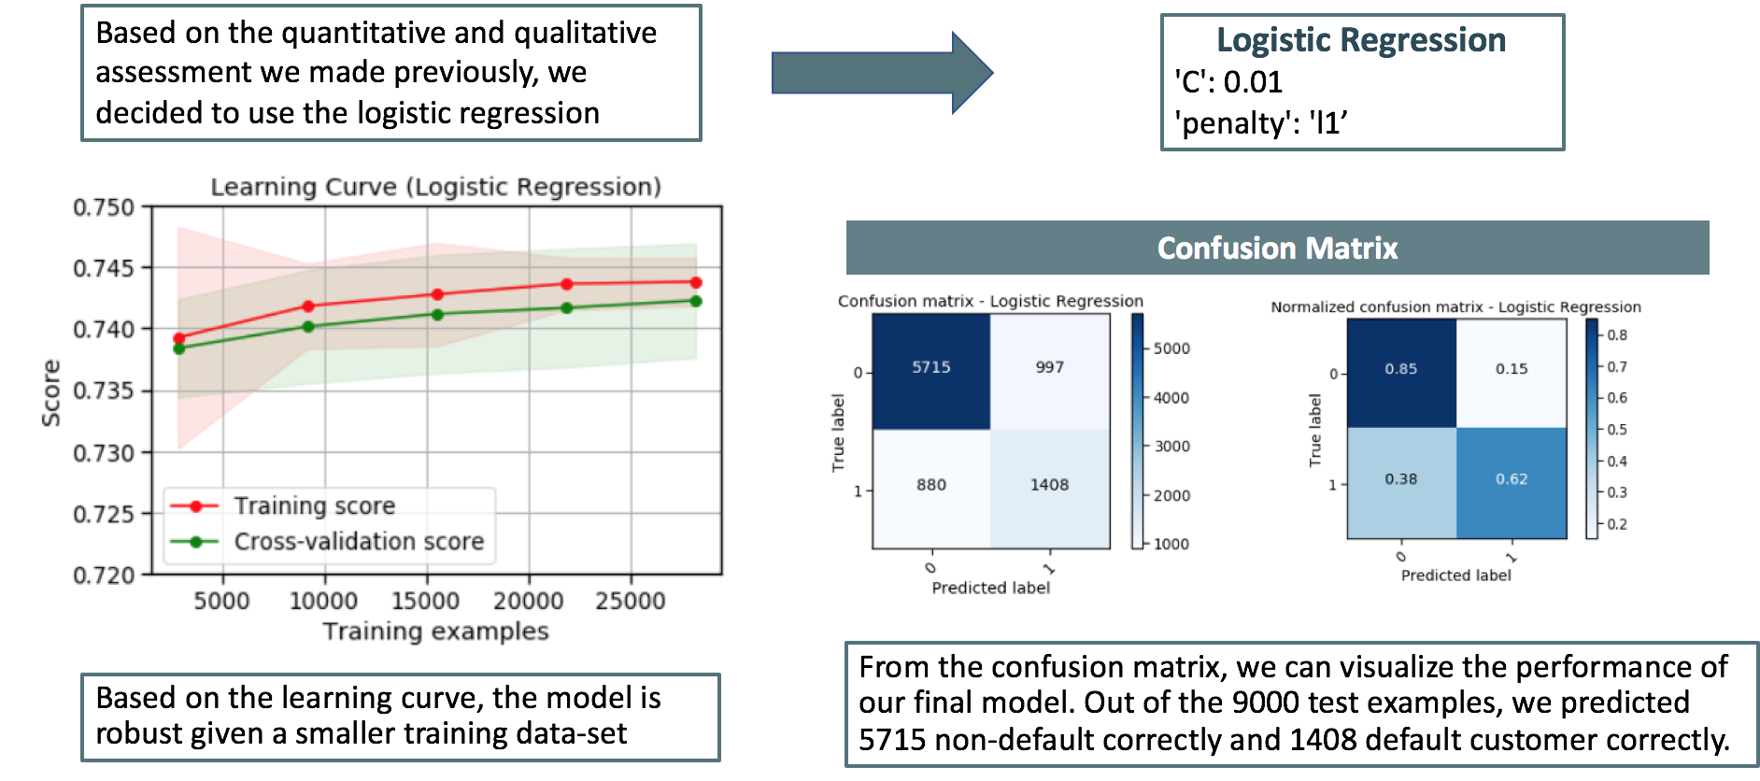
Final Model Selection

Slide 20
Evaluation

Slide 21
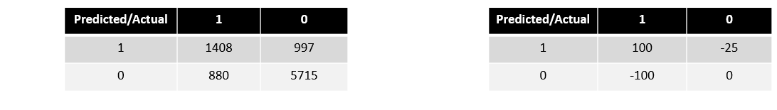
Evaluation
Based on assumptions*, below are the profits per customer for a month for the following events
Profit for correctly predicting an actual default customer = 100$
Profit for wrongly predicting an actual default customer = -100$
Profit for correctly predicting an actual non default customer = 0
Profit for wrongly predicting an actual non default customer = -25$
Confusion Matrix: Benefit Information:
Based on above, the expected profit for our logistic regression model would be $27,875 for the next month

Slide 22
Deployment

Slide 23
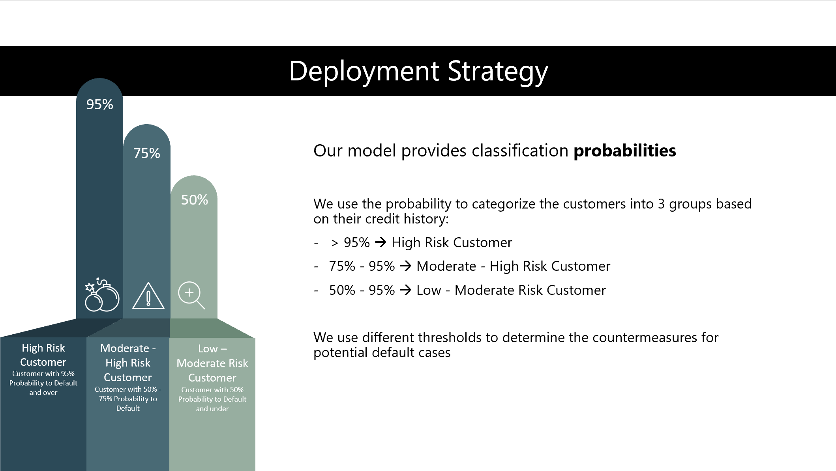

Slide 24
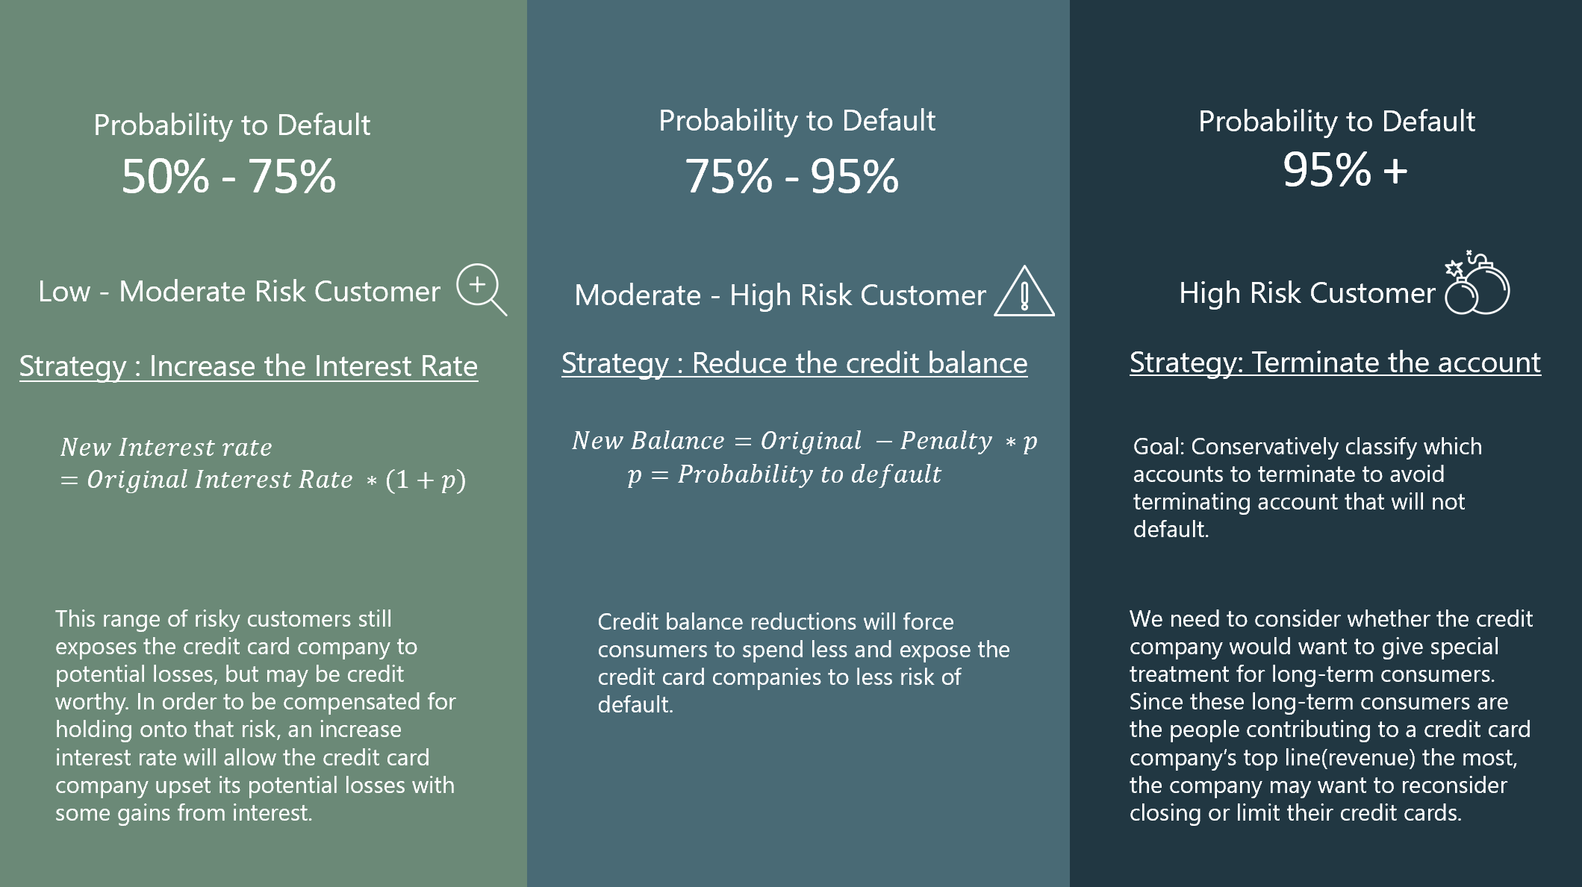

Slide 25
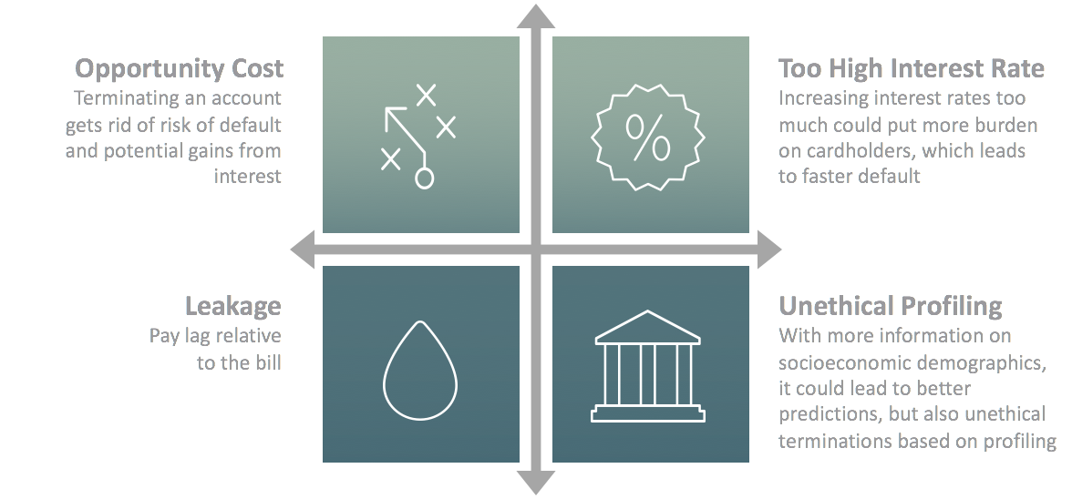
Risk and Mitigation

Slide 26
Appendix

Slide 27
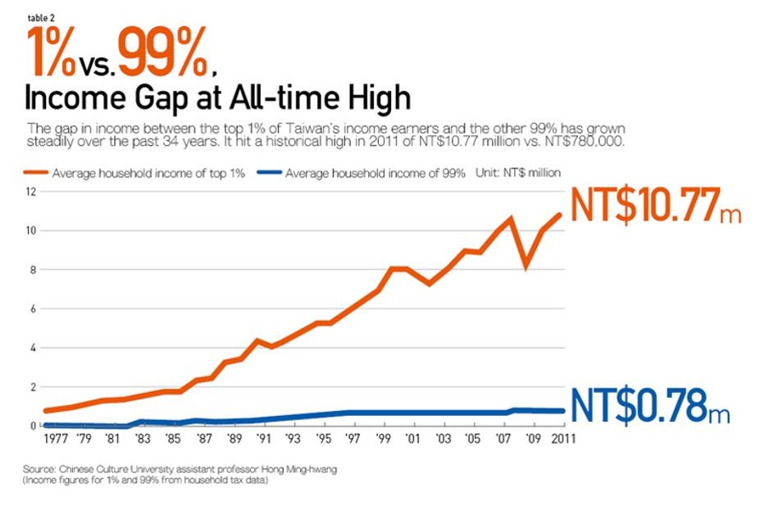

Appendix
Income Skewness Explanation:
The income gap between population led to the skew of credit balance, which is mostly decided by individual's income.

Slide 28
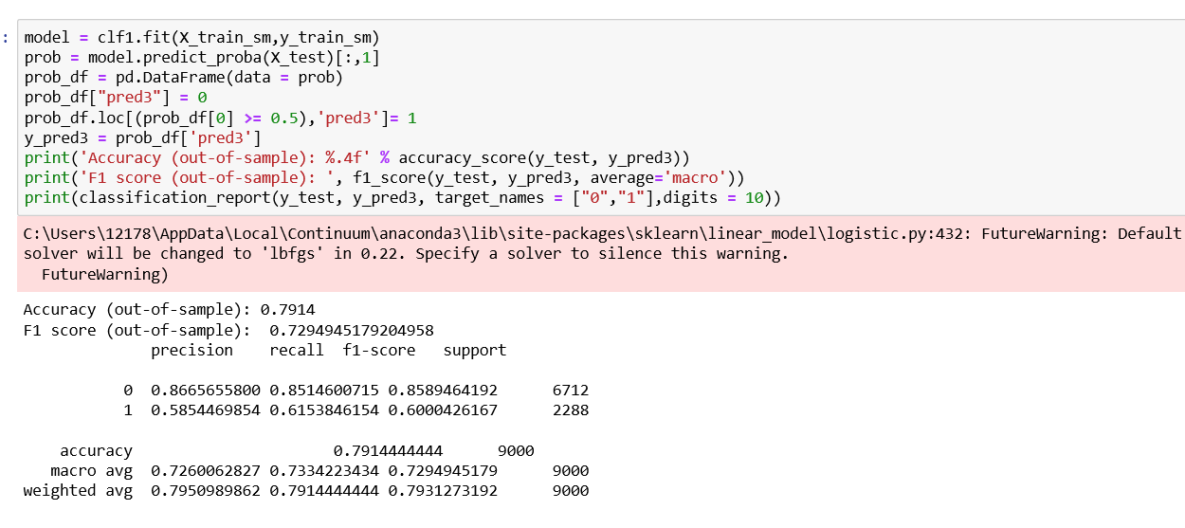
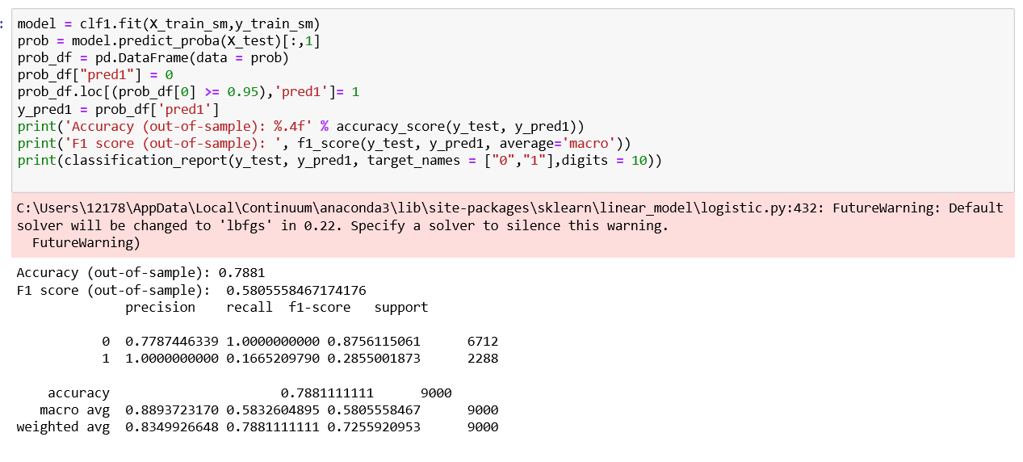
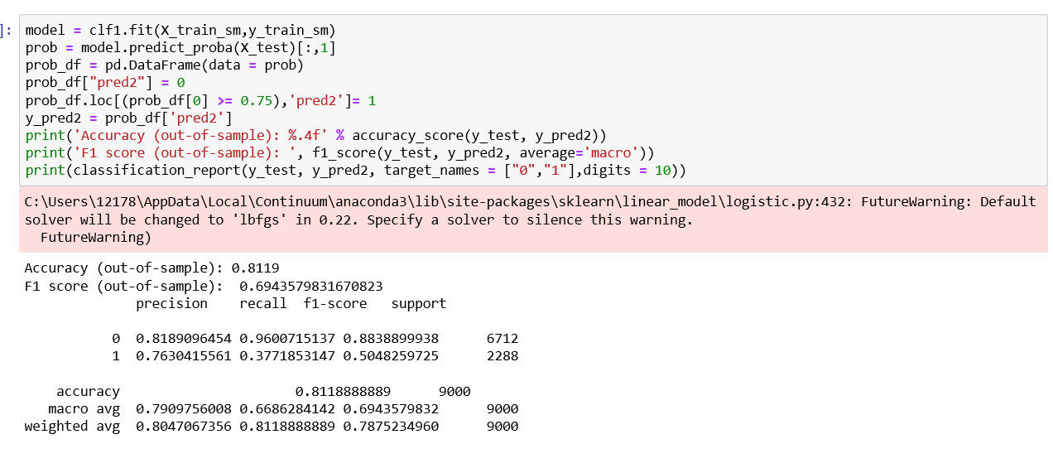
Appendix

Slide 29
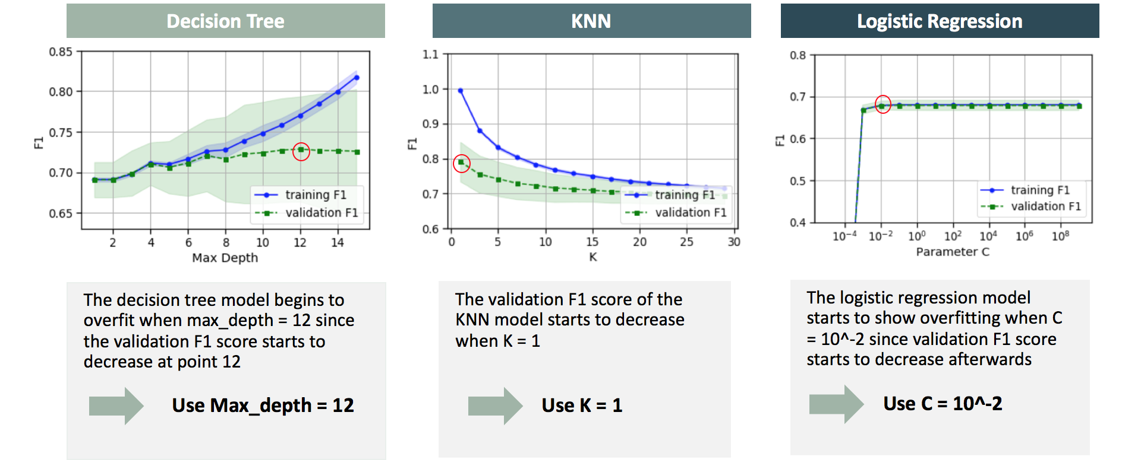
Fitting Graph

Slide 30
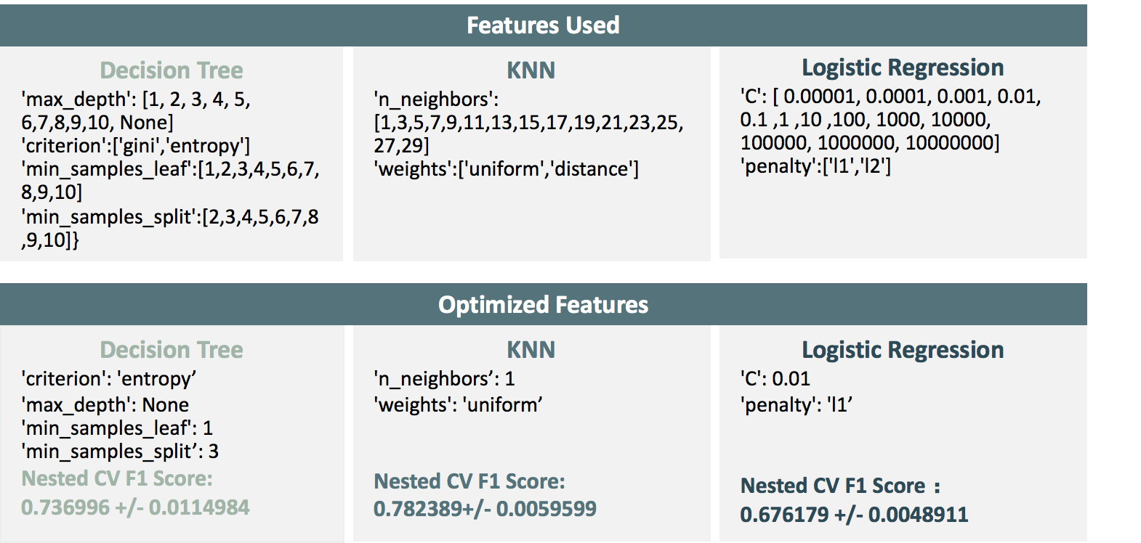
Using Grid Search to Find Optimized Features

Slide 31
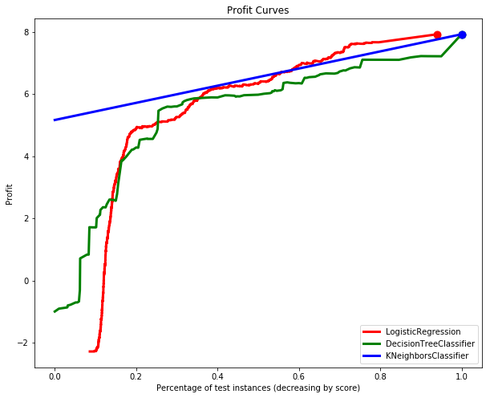
Profit curve demo

